Slide 1
Online MORTGAGE PRE-APPROVAL
Identifying Mortgage Applicants At Risk of Default

Slide 2

U.S. HOUSING MARKET
Short Supply ➨ SELLER’S MARKET
Fannie Mae: Predicts 4.3% Increase in Home Prices (2019)
Millennials becoming first-time home buyers
Market-wide ease in lending standards
After overcorrection from financial crisis
Notes:
https://www.nerdwallet.com/blog/mortgages/housing-mortgage-trends-2019/

Slide 3

MEET THE DEMAND
Online web platform – Immediate Mortgage Pre-Approval
Reach wider customer base throughout US
Objective: quick filter = cost savings:
Reduced overhead
… BUT HOW?

Slide 4

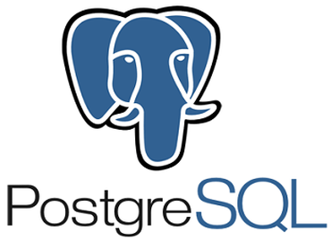



CLASSIFICATION PROBLEM
Determine Default Risk Status for each applicant
Binary Outcomes:
1 >>> “Default Risk”
0 >>> “No Risk”
High class imbalance (12:1)
Oversampling w/ ADASYN
Focus on RECALL
DATA COLLECTION
DATA WRANGLING
Home Credit Default Risk
(Home Credit Group)
INTERACTIVE PLATFORM
ANALYSIS / MODELING
TabPy (Python)
Tableau Desktop
Data Processing
Numpy
Pandas
Data Modeling
Scikit-learn
Imblearn
Data Visualizations
Poltly

Slide 5
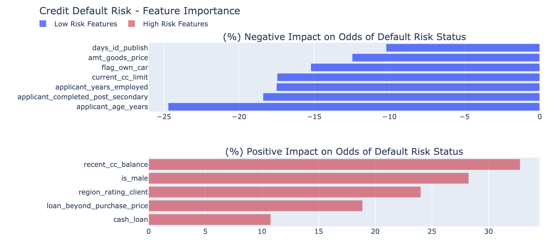
WHAT IMPACTS DEFAULT RISK?

Slide 6
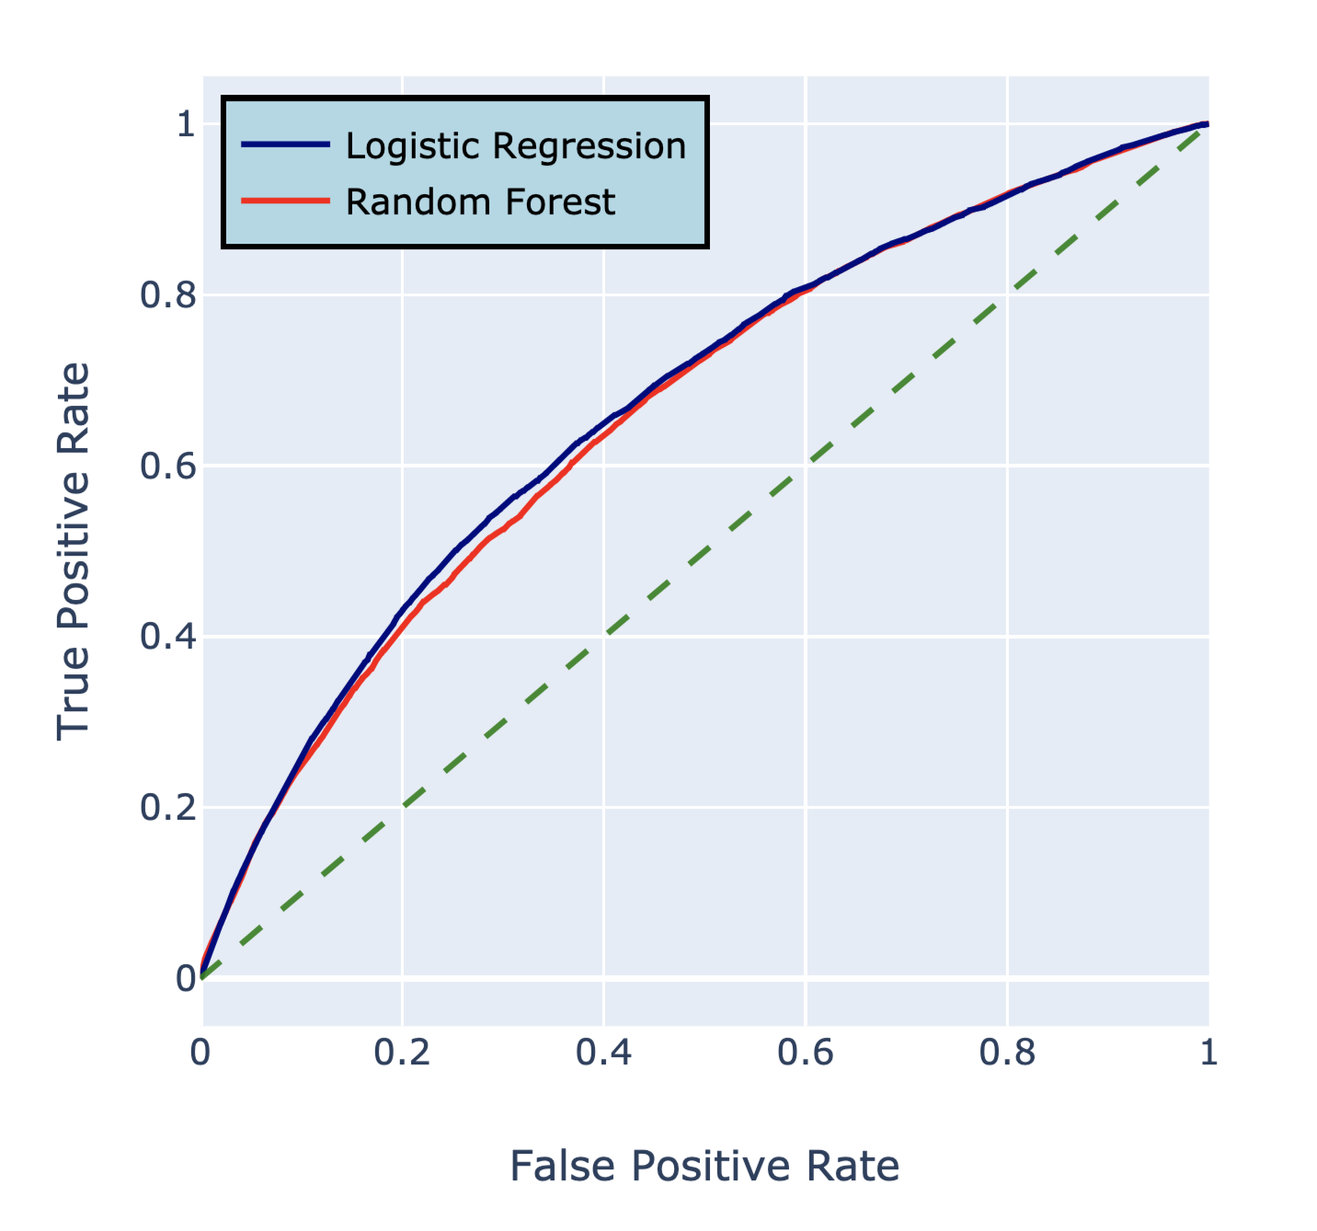
MODEL SELECTION
ROC CURVE – Default Risk
Logistic Regression
vs.
Random Forest
F1 Score ➨ Logistic (19.7%)
Precision ➨ Logistic (11.4%)
Recall ➨ Random Forest (76%)
AUC ➨ Logistic (67%)

Slide 7
OPTIMIZING LOGISTIC REGRESSION
 |  | PREDICTIONS
 |  | NO RISK | AT RISK
RESULTS | NO RISK | True Negative Earned interest revenue $253k / applicant | False Positive Potential loss of interest revenue $253k / applicant
 | AT RISK | False Negative Incur cost of loan default 21% loss on sale ($125.7k) Opportunity cost of future interest revenue ($125.5k) | True Positive Avoid cost of loan default 21% loss on sale ($125.7k) Opportunity cost of future interest revenue ($125.5k)
* Assumptions:
Avg. Mortgage = $600k | 20 year fixed mortgages @ 3.75% | Avg. Default after 5.5 years (20% equity)

Slide 8
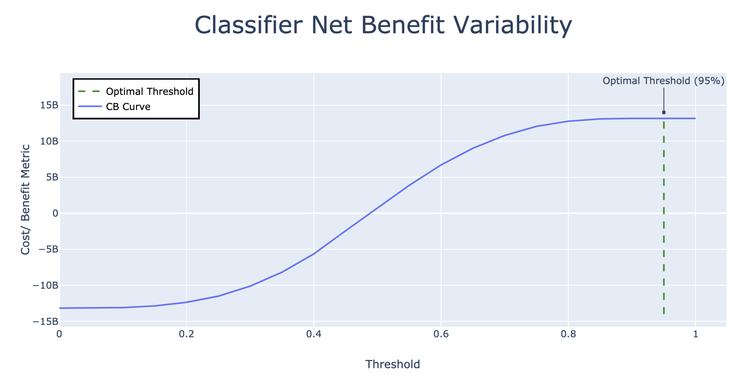
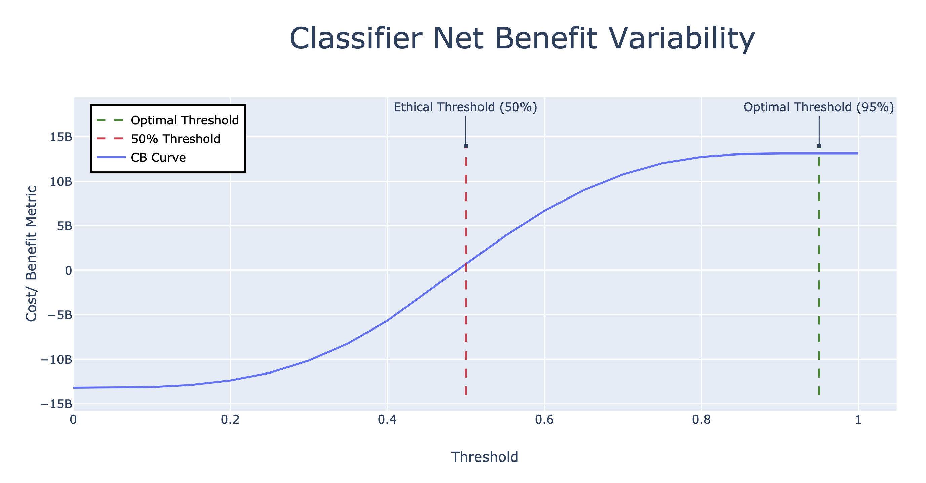
MODEL THRESHOLD
* Based on Test Data: ≅ 62, 000 applicants

Slide 9
OTHER CONSIDERATIONS … beyond Cost/Benefit Analysis
50% Threshold:
Ethical Considerations
Avoiding Predatory Loaning
Federal/State Loan Regulations
 | PREDICTIONS
 | No Risk | At Risk
No Risk | 28,745 | 28,190
At Risk | 1331 | 3668
Recall Score: 73%
Net gain $700M (cost/benefit function)
FP: Online Rejection ≠ Lost Business

Slide 10
